Slide 1
Newspaper Article
Structure

Slide 2
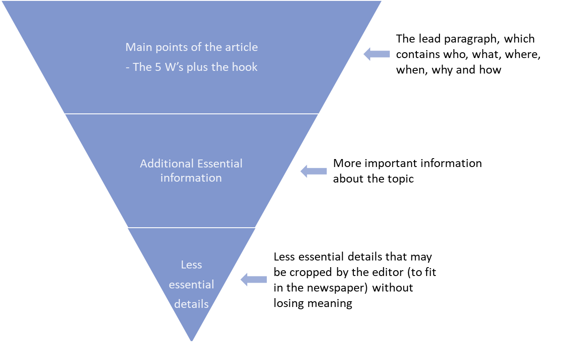

https://www.enchantedlearning.com/newspaper/

