Slide 1
Campbell’s 12 Stages of The Hero’s Journey

Slide 2
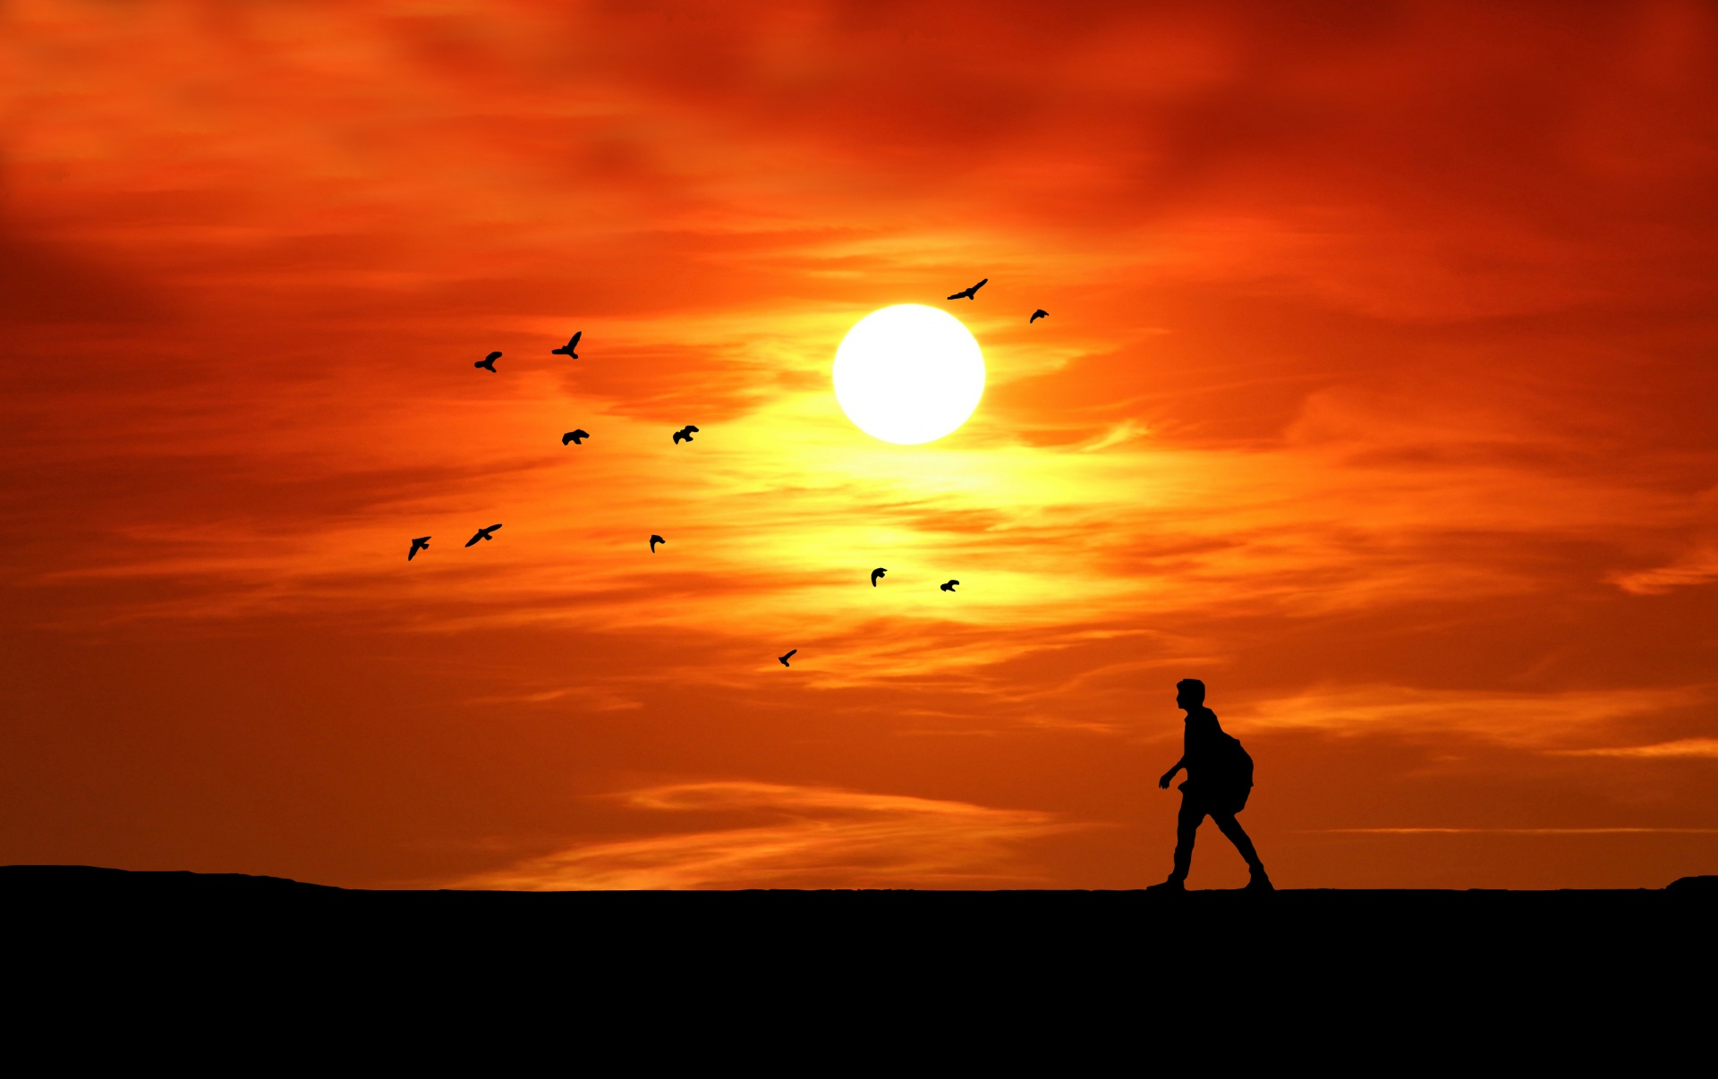

Joseph Campbell describes the journey of the hero as follows:
“A hero ventures forth from the world of common day into a region of supernatural wonder: fabulous forces are there encountered and a decisive victory is won: the hero comes back from this mysterious adventure with the power to bestow boons on his fellow man.”
https://en.wikipedia.org/wiki/Hero%27s_journey

Slide 3
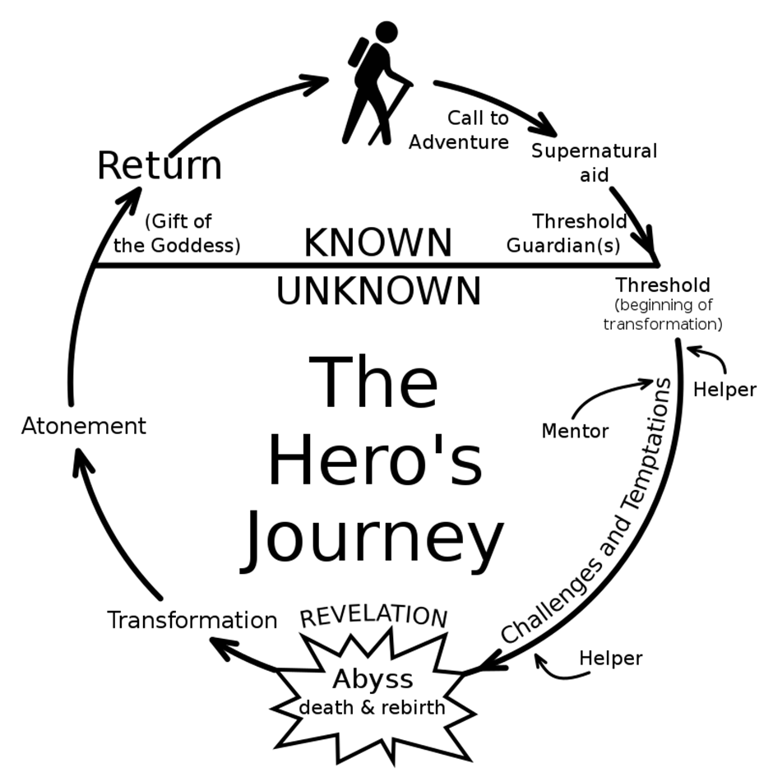
https://en.wikipedia.org/wiki/Hero%27s_journey

Slide 4
12. Return with the Elixir
11. Resurrection
1. Ordinary World
10. The Road Back
2. Call of Adventure
12 STEPS OF THE HERO’S JOURNEY
9. Reward
3. Refusal of the Call
8. Ordeal
4. Meeting the Mentor
7. Approach to the Inmost Cave
5. Crossing the First Threshold
6. Tests, Allies, Enemies

Slide 5
12 STEPS OF THE HERO’S JOURNEY
STEP 1: The Ordinary World
This is where the Hero exists before his adventure begins.
He is oblivious of the adventures to come.
He is as human as the reader.
This makes it easier to identify and empathize with him.

Slide 6
12 STEPS OF THE HERO’S JOURNEY
STEP 2: Call to Adventure
The Hero's adventure receives a call to action.
This is a threat to his safety, family, way of life or his community.
It disrupts the comfort of his ordinary world.
It presents a challenge or quest that must be undertaken.

Slide 7
12 STEPS OF THE HERO’S JOURNEY
STEP 3: Refusal of the Call
The hero may be eager to accept the quest.
Second thoughts or personal doubts will cause him to refuse the call.
He will undergo a period of suffering because of this refusal.

Slide 8
12 STEPS OF THE HERO’S JOURNEY
STEP 4: Meeting the Mentor
The hero will meet a mentor who will guide him in accepting the challenge.
The mentor will dispel his doubts and fears.
He will give him the strength and courage to begin his quest.

Slide 9
12 STEPS OF THE HERO’S JOURNEY
STEP 5: Crossing the First Threshold
He begins his challenge, whether it be physical, spiritual or emotional.
He crosses over from the world he is familiar with, into the unfamiliar.
Crossing the first threshold signifies his commitment to his journey.

Slide 10
12 STEPS OF THE HERO’S JOURNEY
STEP 6: Tests, Allies, Enemies
He is out of his comfort zone.
His skills and powers are tested as he overcomes his obstacles.
Allies and enemies will help prepare him for the ordeals to come.
Every obstacle he faces gives us deeper insight into his character and we identify with him more.

Slide 11
12 STEPS OF THE HERO’S JOURNEY
STEP 7: Approach to the Inmost Cave
The inmost cave maybe literal or figurative.
He prepares to take that final leap into the great unknown.
At the threshold to the inmost cave he may again face doubts and fears.
This intensifies the magnitude of the ordeal and escalates the tension.

Slide 12
12 STEPS OF THE HERO’S JOURNEY
STEP 8: The Ordeal
This may be a physical test or an inner crisis that he has to survive.
He must use the skills and experiences gathered along the way.
He can be reborn through a metaphorical resurrection, giving him power or insight to fulfill his destiny.
If he fails, he will either die or his life will never be the same.

Slide 13
12 STEPS OF THE HERO’S JOURNEY
STEP 9: Reward
The Hero is now transformed into a new state, emerging from the challenge stronger and often with a reward.
The reward will facilitate his return to the Ordinary World.
He must first complete the last leg of his journey - the return home - before he celebrates.

Slide 14
12 STEPS OF THE HERO’S JOURNEY
STEP 10: The Road Back
This is a reverse echo of the Call to Adventure.
He must return with his reward to acclaim, vindication or absolution.
He may still need one last push back into the Ordinary World.
He must choose between his personal objective and a Higher Cause.

Slide 15
12 STEPS OF THE HERO’S JOURNEY
STEP 11: Resurrection
This is the climax - his dangerous encounter with death.
The battle represents something far greater than this own existence.
If he fails, others will suffer.
The Hero will succeed, destroy his enemy and emerge from battle, reborn.

Slide 16
12 STEPS OF THE HERO’S JOURNEY
STEP 12: Return with the Elixir
He returns home to his Ordinary World a changed man.
His return will bring new hope, a solution or a new perspective for others.
TThe final reward may be literal or a metaphor. It represents three things:
change, success and proof of his journey.
His return may signal the need for resolution for other characters.

Slide 17
Adapted from:
http://www.movieoutline.com/articles/the-hero-journey-mythic-structure-of-joseph-campbell-monomyth.html
https://en.wikipedia.org/wiki/Hero%27s_journey

