Slide 1
Poster Design Discussion

Slide 2
1. WHAT IS THE TOPIC/THEME OF THE ADVERT/POSTER?
2. What is the intention of the advert/poster?
3. How is the intention achieved in the visual and copy?
VISUAL
COPY
4. What is the historical/social context?
1.List the things you see. How do they relate to the topic/theme?
1. List key words/phrases. How do they relate to the topic/theme?
5. Is the message implied/direct? How?
2. What is the significance of the colours used, including the background?
6. How is harmony and/or contrast used?
2. Critically look at diction in headlines/captions.
7. What stereotype is used/challenged?
3. Consider the use of language decvices and punctuation.
3. Consider the use of font type and size.
Look at layout and design.
8. Who is the target audience?
4. Look at how emotions are exploited.
9. How has AIDA been used?

Slide 3
https://www.google.com/search?q=human+trafficking+posters&sxsrf

Slide 4
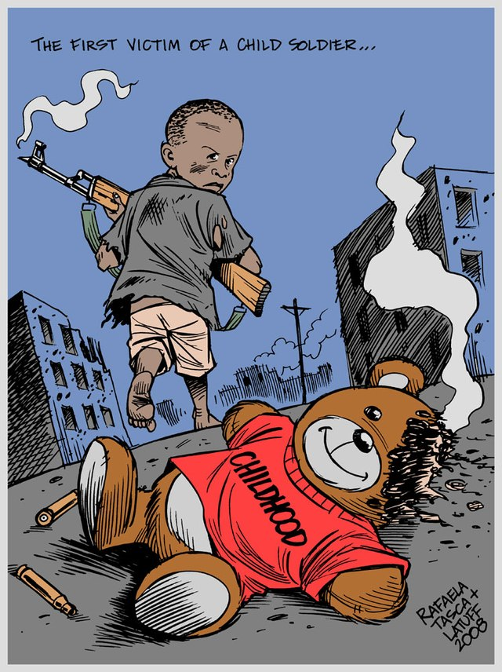
https://www.google.com/search?q=the+first+victim+of+a+child+soldier+is++childhood+posters&tbm

Slide 5
https://www.google.com/search?q=amnesty+international+rposters&tbm=isch&vrf

Slide 6
CREATE YOUR OWN POSTER

Slide 7
1. Decide on a topic/theme.
2. Be clear in your intention for the poster.
VISUAL
3. What techniques will you use in the visual and copy?
COPY
1. Items/people - How will they relate to the topic/theme?
4. Consider the historical/social context.
1. Use of words/phrases. How will they relate to the topic/theme?
5. Use harmony and/or contrasts.
2. Choice of words for headlines/captions.
2. Choice of colours for foreground and background? Why?
6. Will stereotypes be used/challenged?
7. Who is the target audience?
3. Effective use of language devices and punctuation.
3. Consider the use of font type, size, layout and design.
8. How will AIDA be used?
4. What emotions are you appealing to? How?

