Slide 1
Rights & Responsibilities

Slide 2
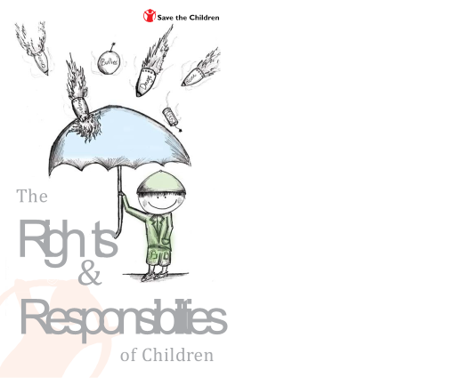


Slide 3
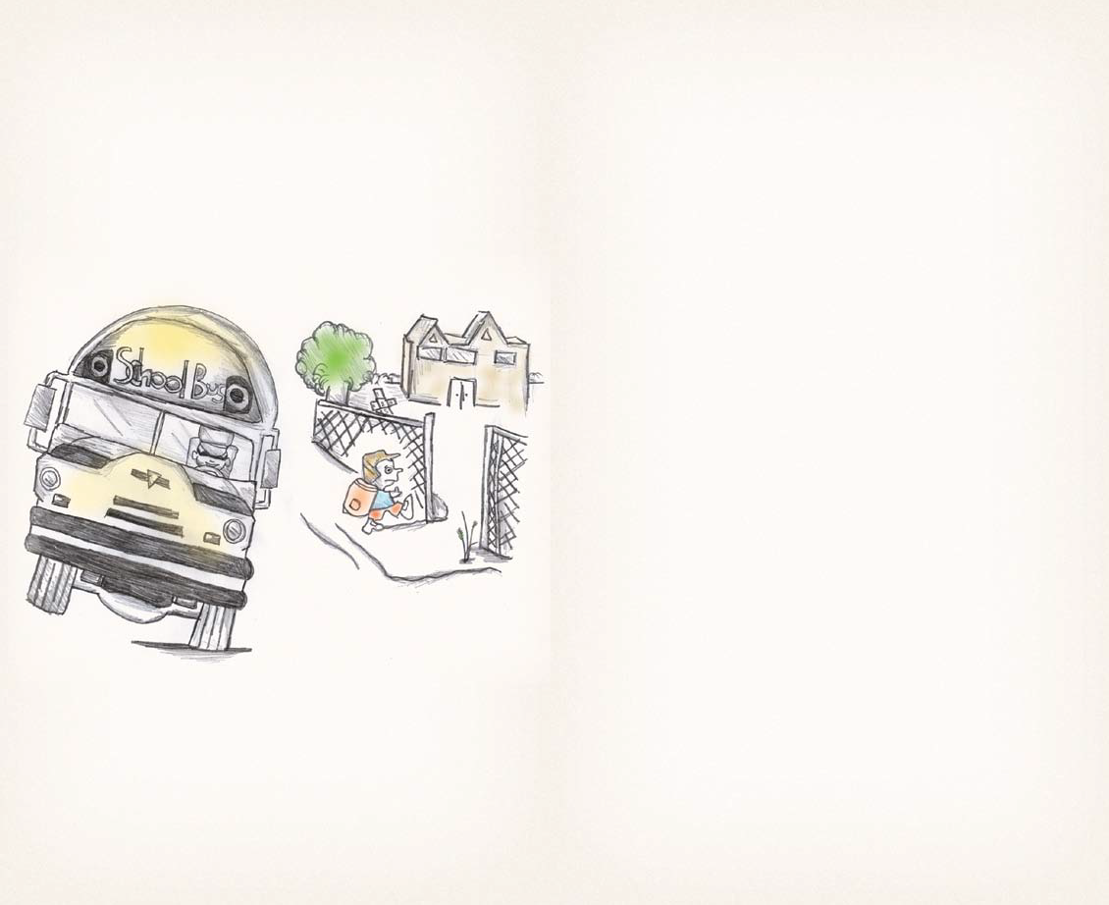
Children have a right to …
an education that develops their personality and abilities, and encourages them to respect other people, cultures and the environment,
and they have the responsibility to …
make the most of their education and encourage others to develop their abilities.

Slide 4
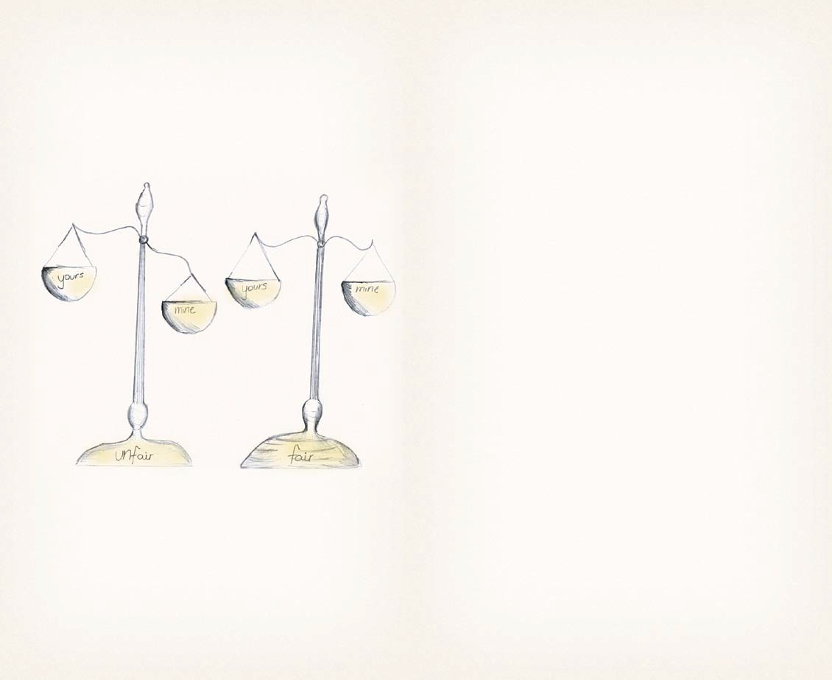
Children have a right to …
be treated fairly no matter who they are, where they are from, what language they speak, what they believe or where they live,
and they have the responsibility to …
always treat others fairly.

Slide 5
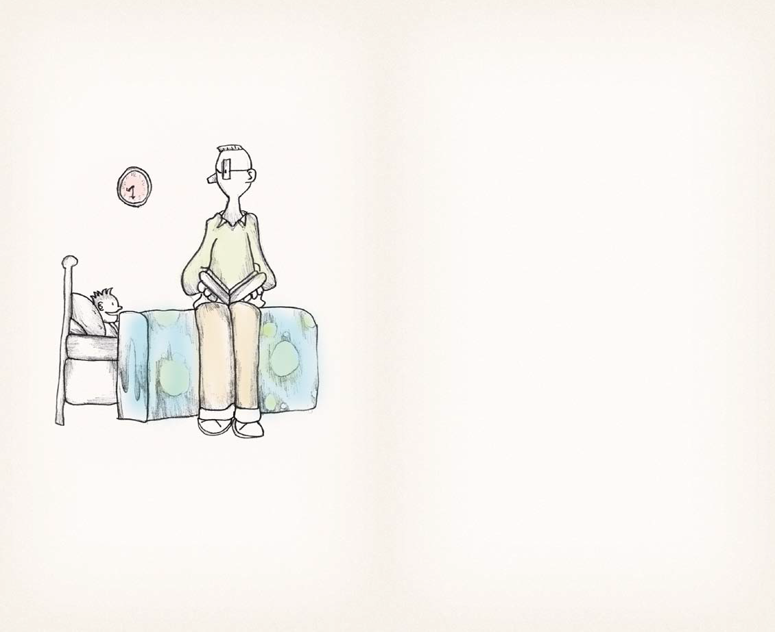
Children have a right to …
have adults always do what is best for them,
and they have the responsibility to …
respect adults for doing what is best for them.

Slide 6
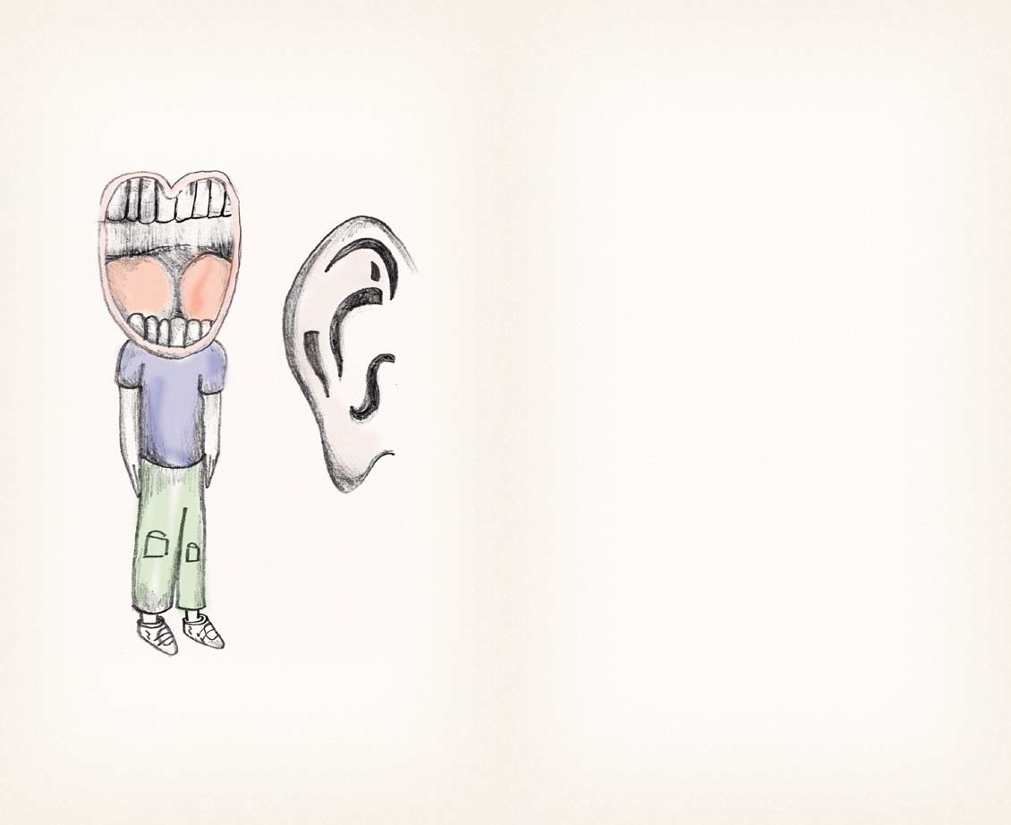
Children have a right to …
have their own opinion, which is listened to and taken seriously,
and they have the responsibility to …
listen to other people’s opinions and take them seriously.

Slide 7
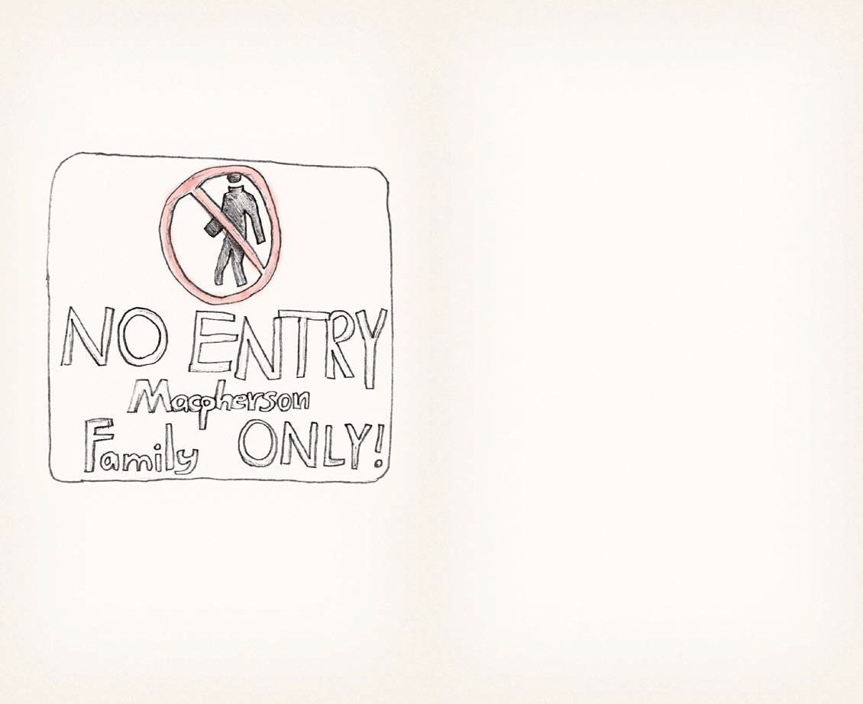
Children have a right to …
have their privacy and family respected,
and they have the responsibility to …
respect the family and privacy of others.

Slide 8
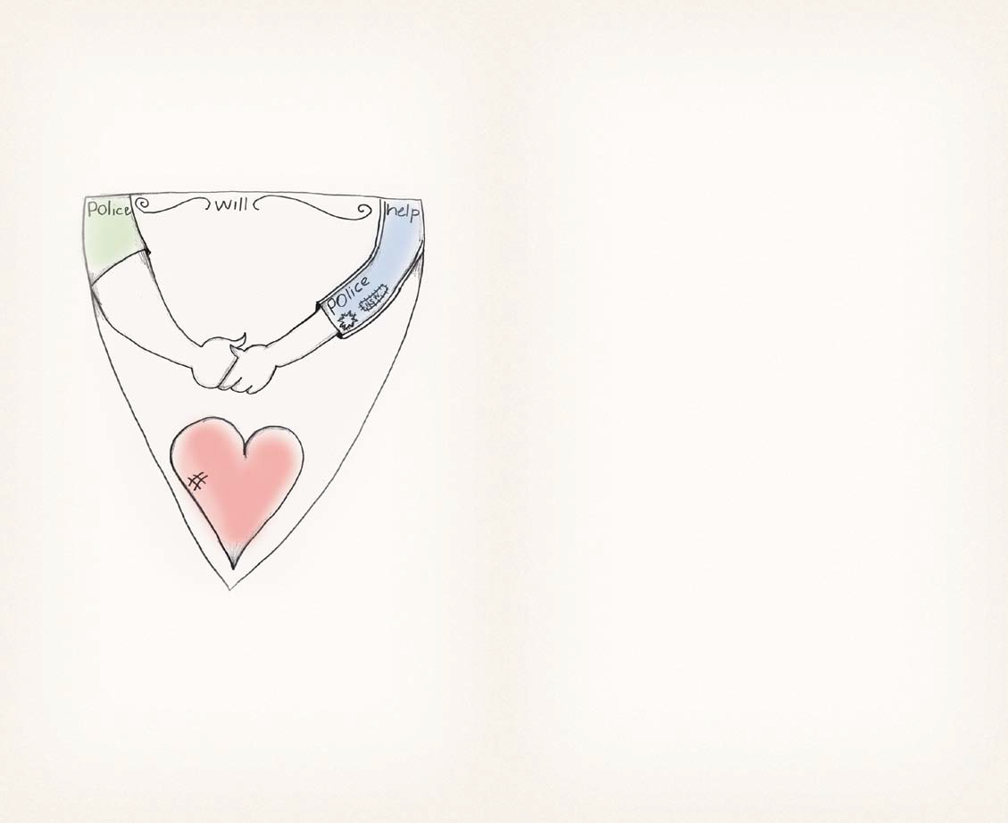
Children have a right to …
be protected from being hurt or badly treated in any way,
and they have the responsibility to …
not hurt others or treat them badly.

Slide 9
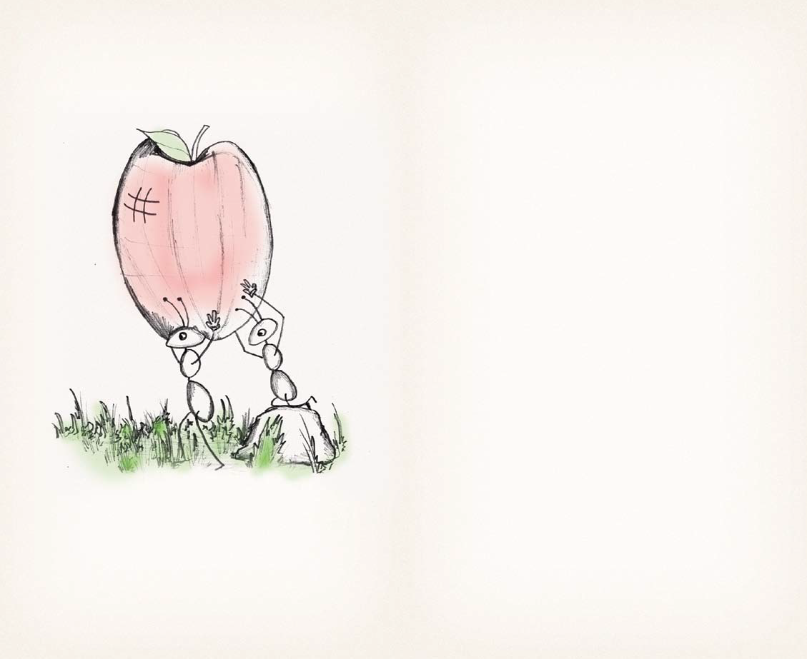
Children have a right to …
the best health care and medical care possible and information to help them stay healthy,
and they have the responsibility to …
maintain good health and help others have access to good health care.

Slide 10
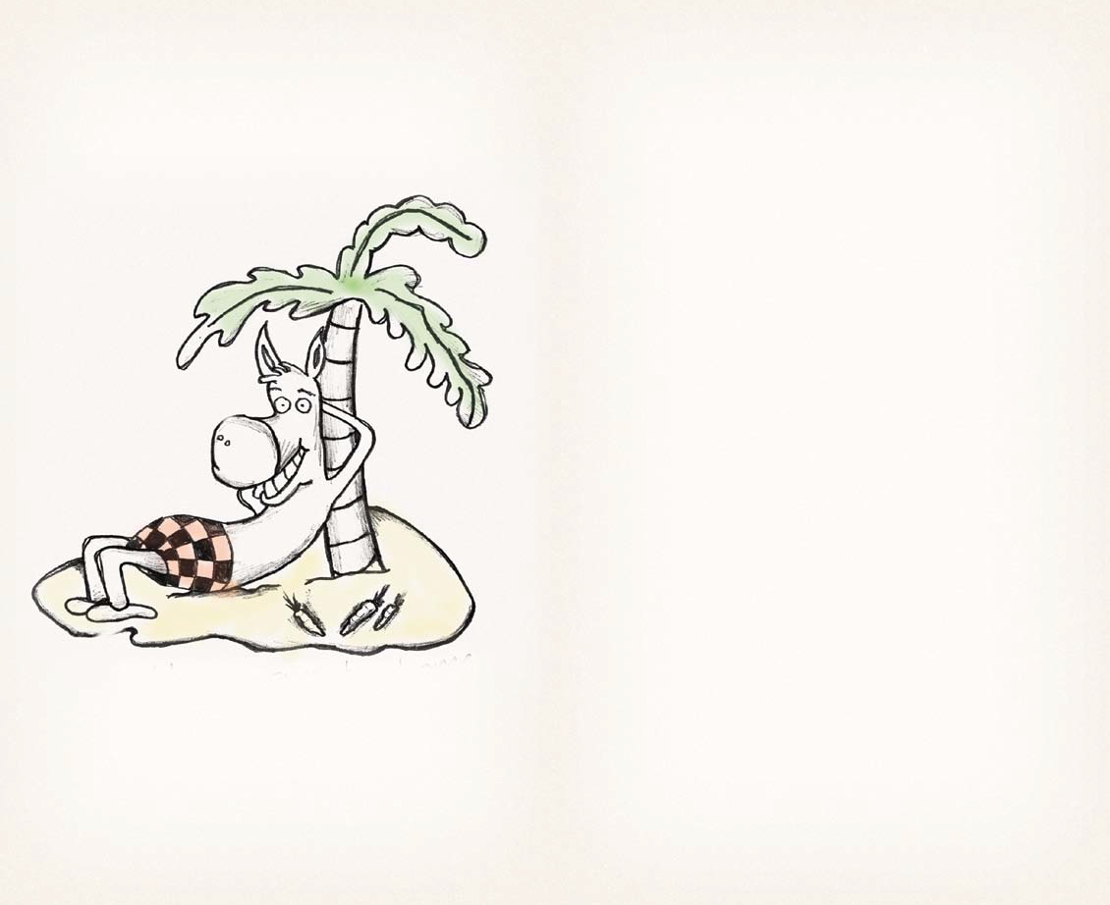
Children have a right to …
a basic standard of living that includes food, clothing and a safe place to live,
and they have the responsibility to …
appreciate their living standards and help others to improve their standards.

Slide 11
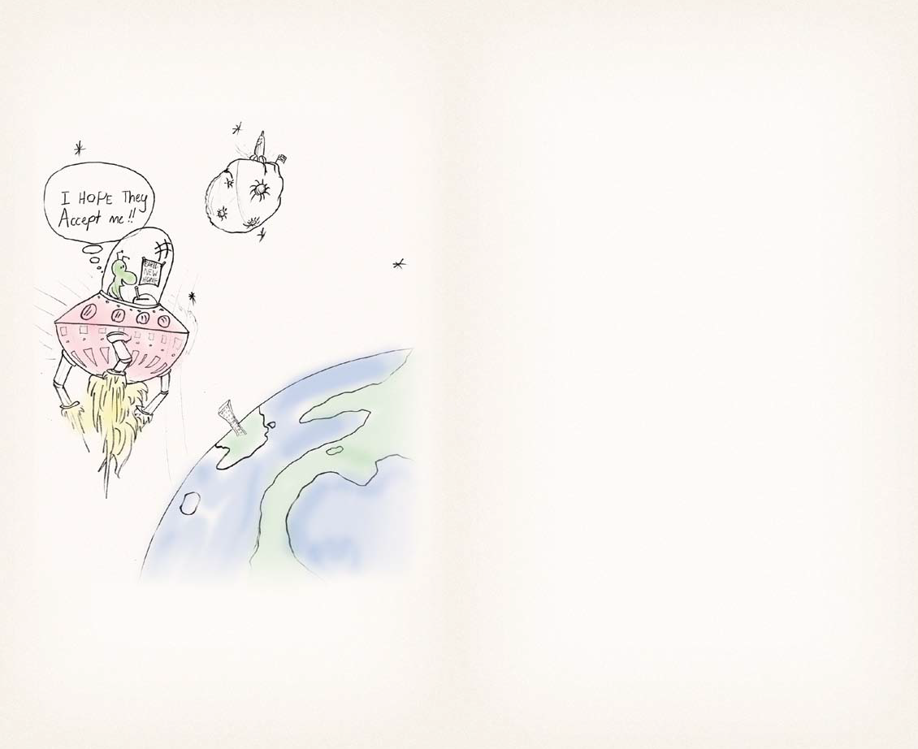
Children have a right to …
enjoy their own culture, religion and language, even if these are not the same as most people in their country,
and they have the responsibility to …
respect other people’s culture, religion and language.

Slide 12
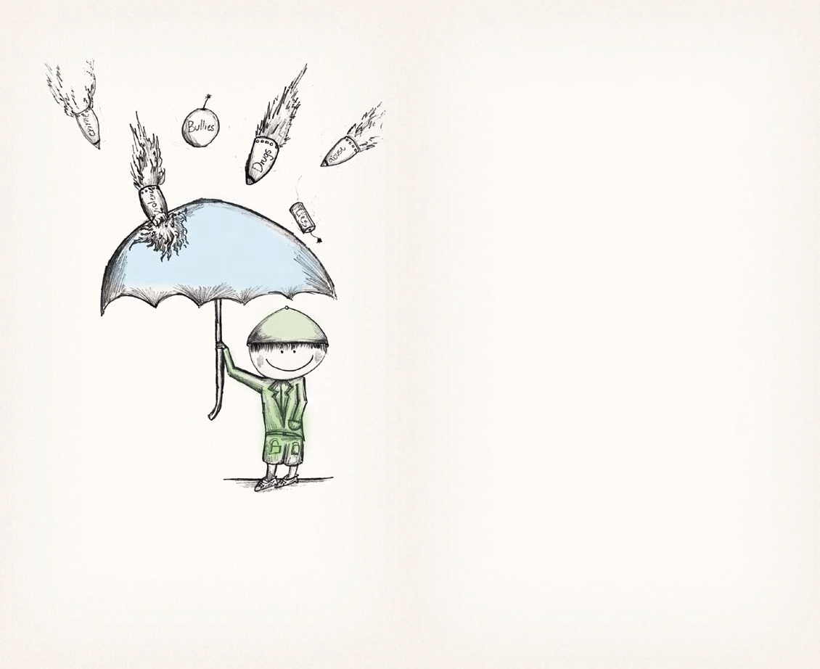
Children have a right to …
be protected from being exploited in any way,
and they have the responsibility to …
not exploit others.

Slide 13
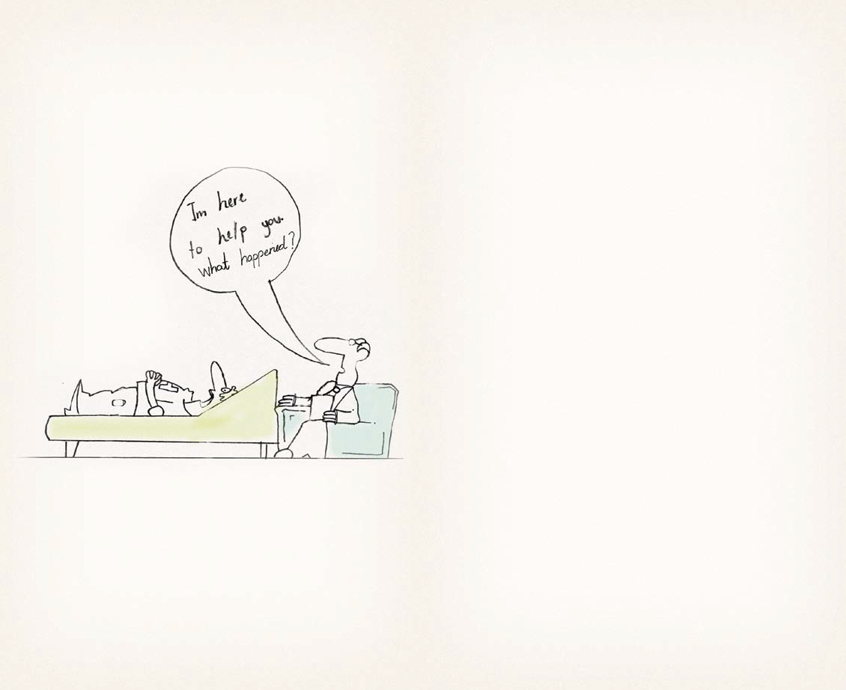
Children have a right to …
special help if they have been hurt, neglected or badly treated,
and they have the responsibility to …
tell a trusted adult if they have been hurt, neglected or badly treated so they can help.

Slide 14
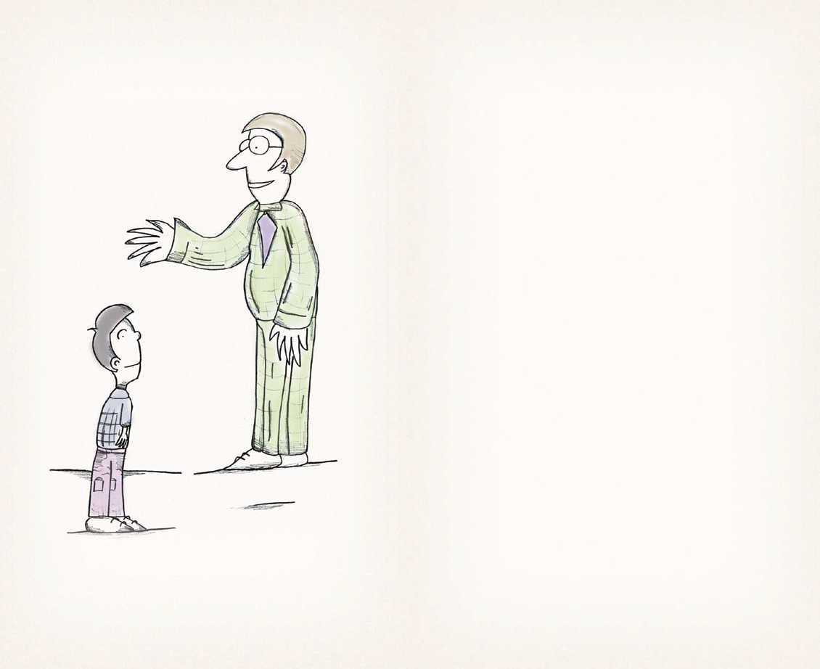
Children have a right to …
be given support and advice from their parents and family,
and they have the responsibility to …
accept the support and listen to the advice given.

Slide 15
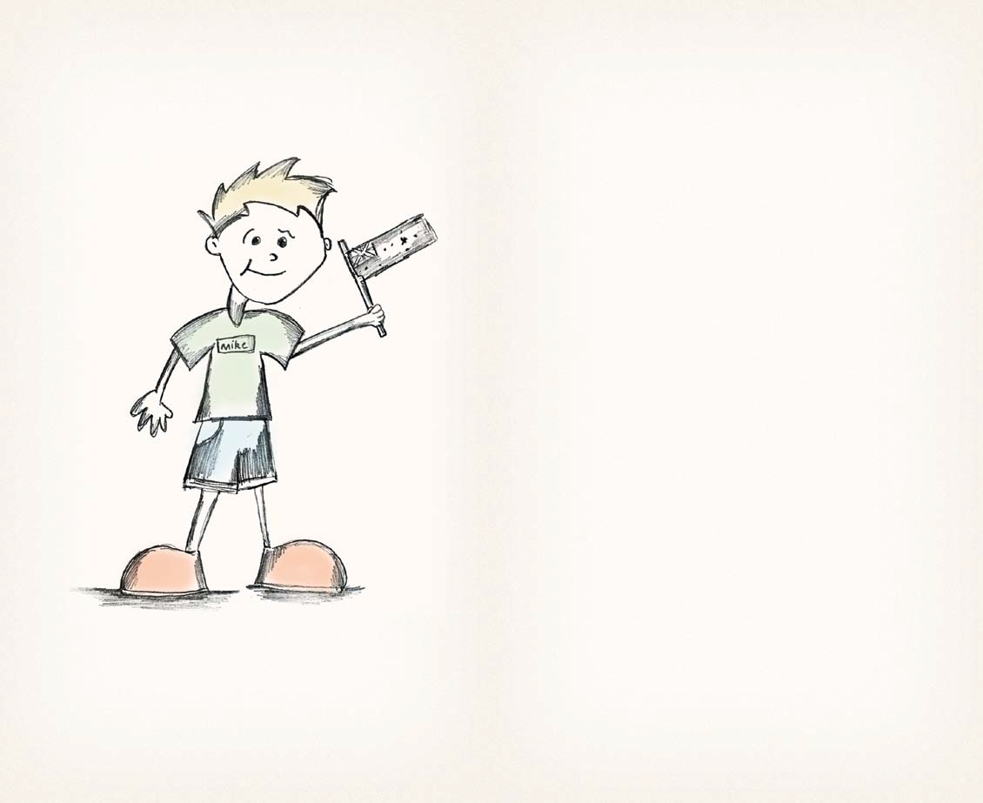
Children have a right to …
have a name and nationality,
and they have the responsibility to …
respect other people’s names and nationalities.

Slide 16
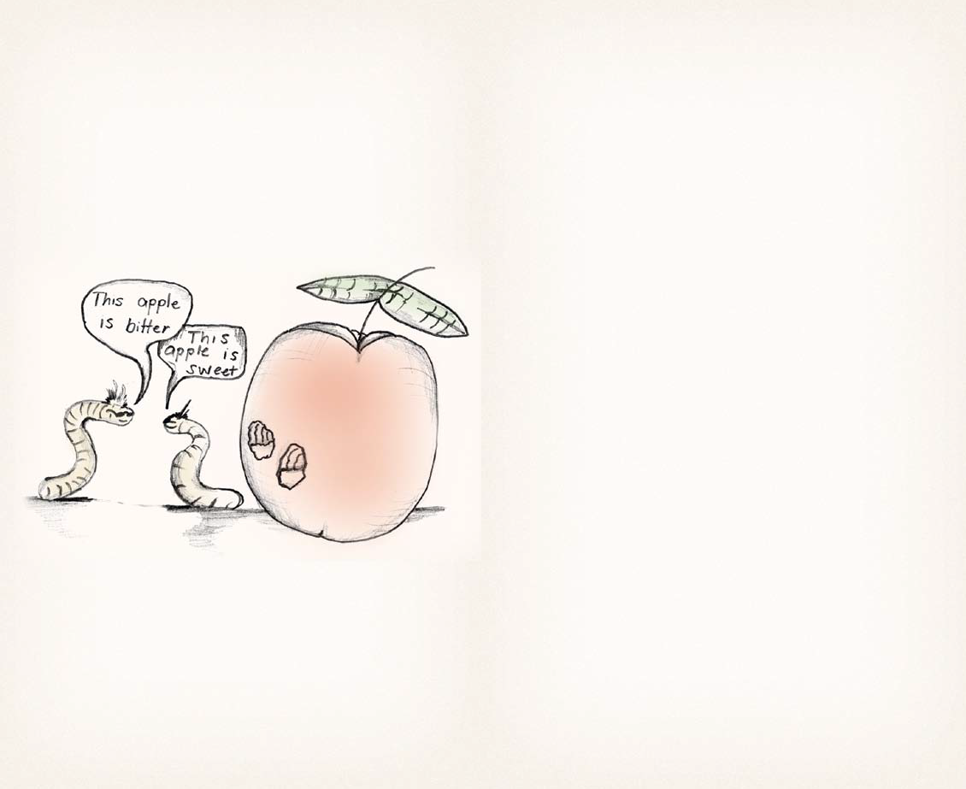
Children have a right to …
find out information and express what they think through speaking, writing, art, unless this denies other people their rights,
and they have the responsibility to …
allow others to express their thoughts even if they are different.

Slide 17
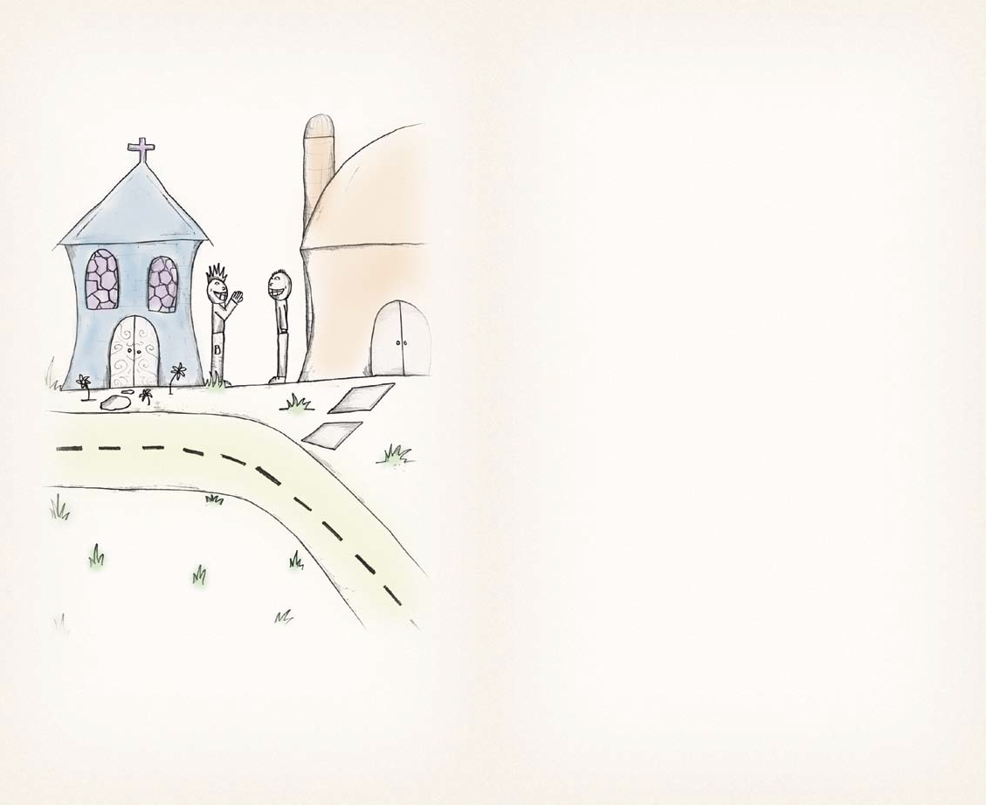
Children have a right to …
think and believe whatever they want and practice any religion, with guidance from their parent/s,
and they have the responsibility to …
respect the right of others to think and believe what they want.

Slide 18
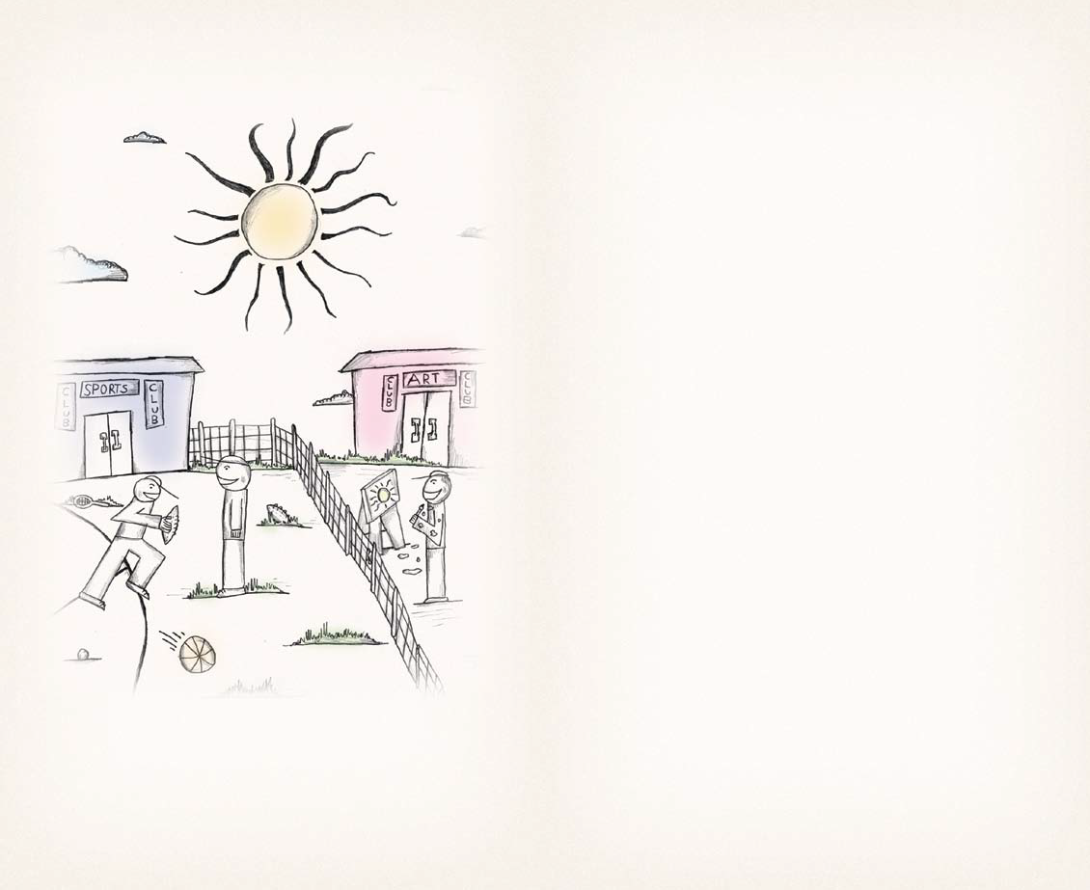
Children have a right to …
be friends and join clubs, unless this denies other people of their rights,
and they have the responsibility to …
allow others to choose their friends and join clubs.

Slide 19
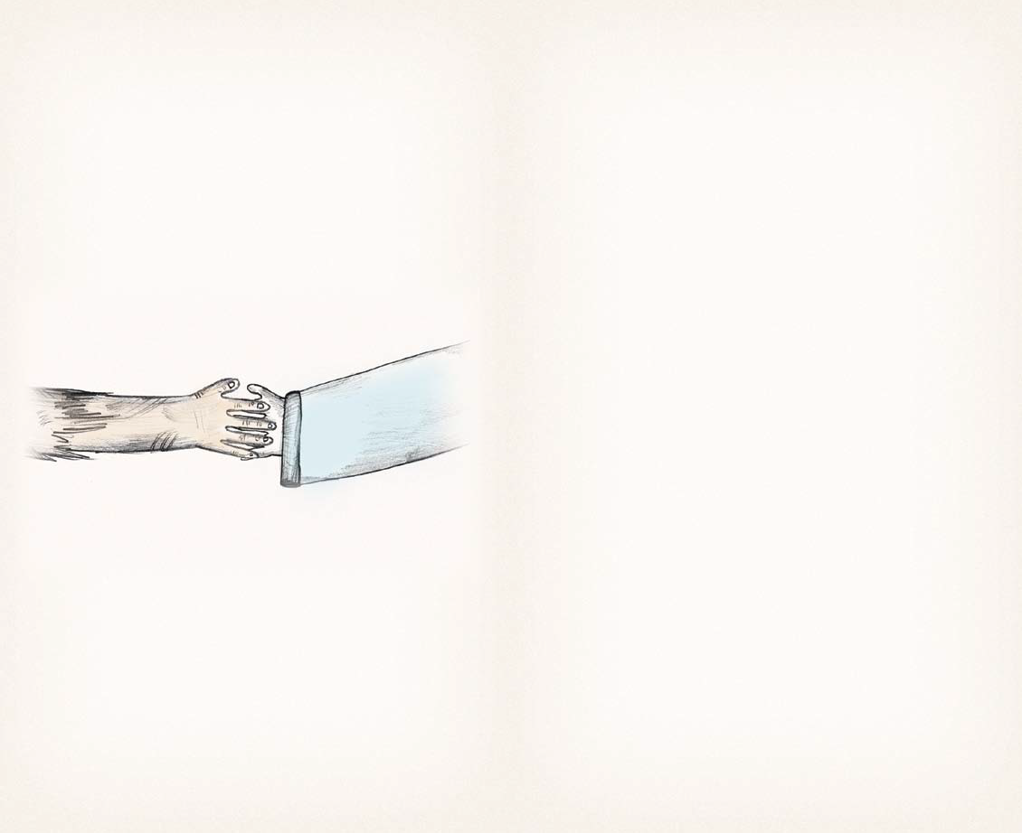
Children have a right to …
get help from the government if they are poor or in need,
and they have the responsibility to …
participate in society and to help others who are poor or in need.

Slide 20
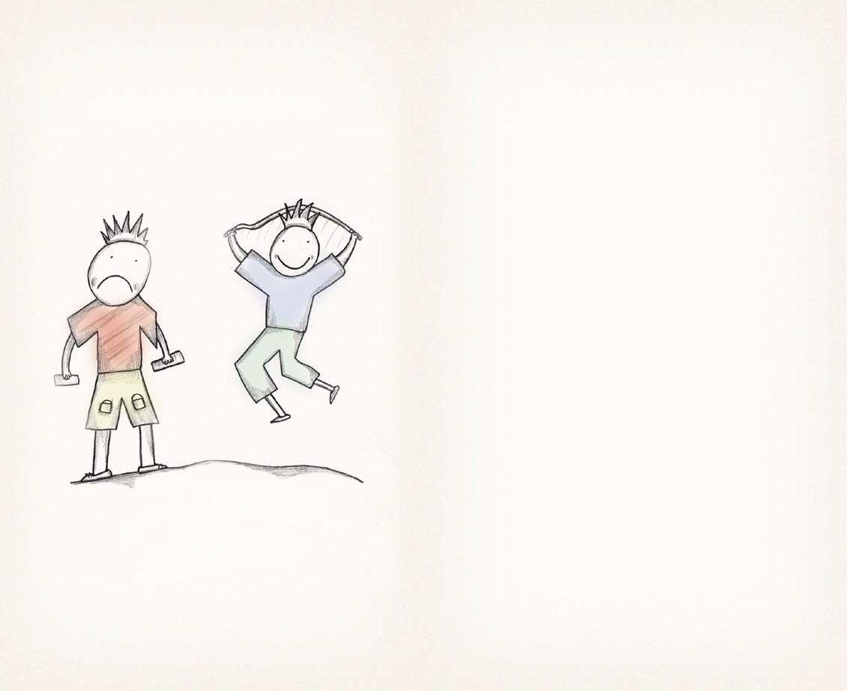
Children have a right to …
be protected from work that harms their health or interferes with
their education,
and they have the responsibility to …
keep safe.

Slide 21
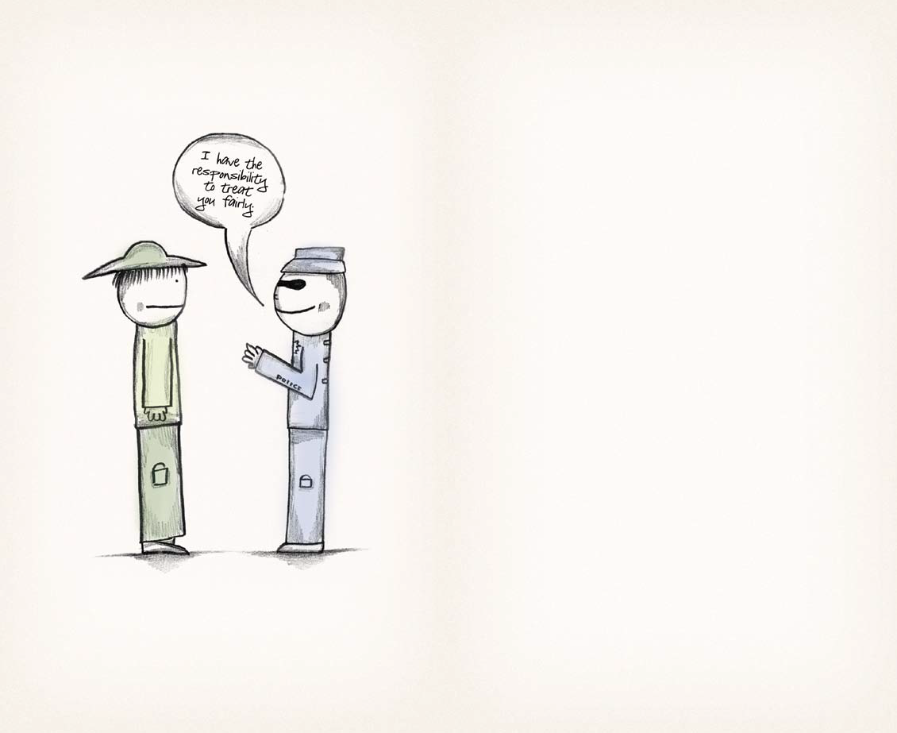
Children have a right to …
be helped and treated fairly if they are accused of breaking the law,
and they have the responsibility to …
report any unfair treatment.

Slide 22
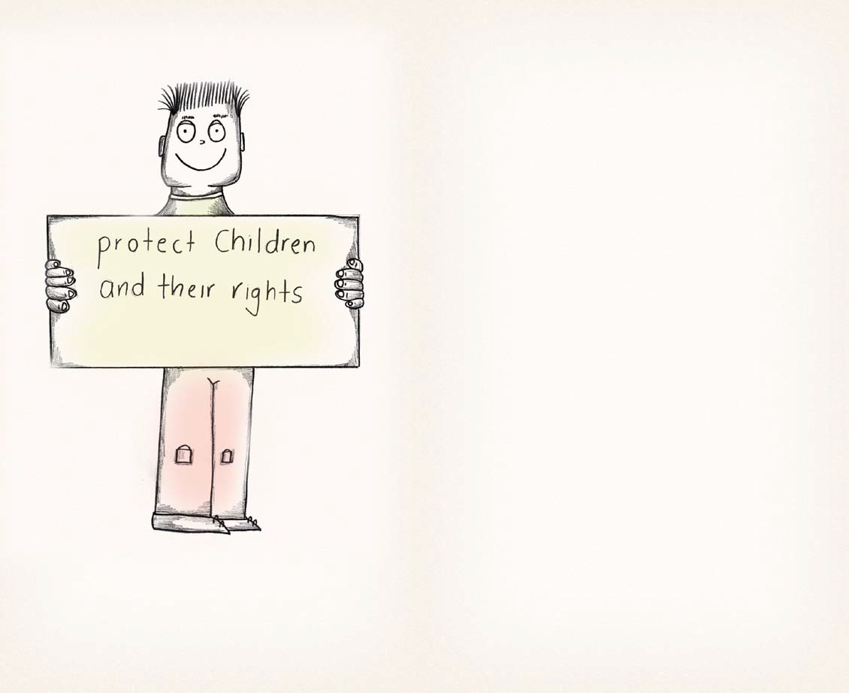
Children have a right to …
have all these rights protected by their government,
and they have the responsibility to …
be aware of these rights and advocate for them to be protected.

Slide 23


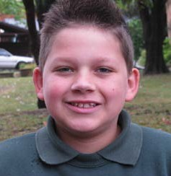
History of Save the Children
Illustrations by Zachariah Mac Pherson 10 years old
Save the Children has been fighting for children’s rights since 1919.
A remarkable woman named Eglantyne Jebb and her sister Dorothy were so concerned that the blockades to enemy countries during World War I were cutting off the food supply and affecting children, that they formed a group called Save the Children to provide aid to children across Europe.
Whilst hiking up Mount Saleve in Geneva in 1923, Eglantyne penned her most enduring legacy. Pausing to rest halfway up the mountain, she jotted down five directives she believed were the fundamental rights of every child.
Other Useful Websites:
United Nations
www.un.org/Pubs/CyberSchoolBus
Determined that her vision would become a reality, Eglantyne lobbied the League of Nations until they adopted these rights in 1924. From there, they would form the basis of the United Nations Declaration of the Rights of the Child in 1959.
UNICEF
www.unicef.org
Australian Human Rights Commission
www.hreoc.gov.au
Since its beginning over 90 years ago, Save the Children has grown to become the world’s largest independent child rights development organisation, making a difference to children’s lives in over 100 countries. From emergency relief to long-term development, Save the Children secures a child’s right to health, education and protection.
Committee on the Rights of the Child
www2.ohchr.org/english/bodies/crc
National Children and Youth Law Centre
www.ncylc.org.au
Human Rights Watch
www.hrw.org/campaigns.crp/index.htm
44.
savethechildren.org.au

