Slide 1
The History of Sierra Leone

Slide 2
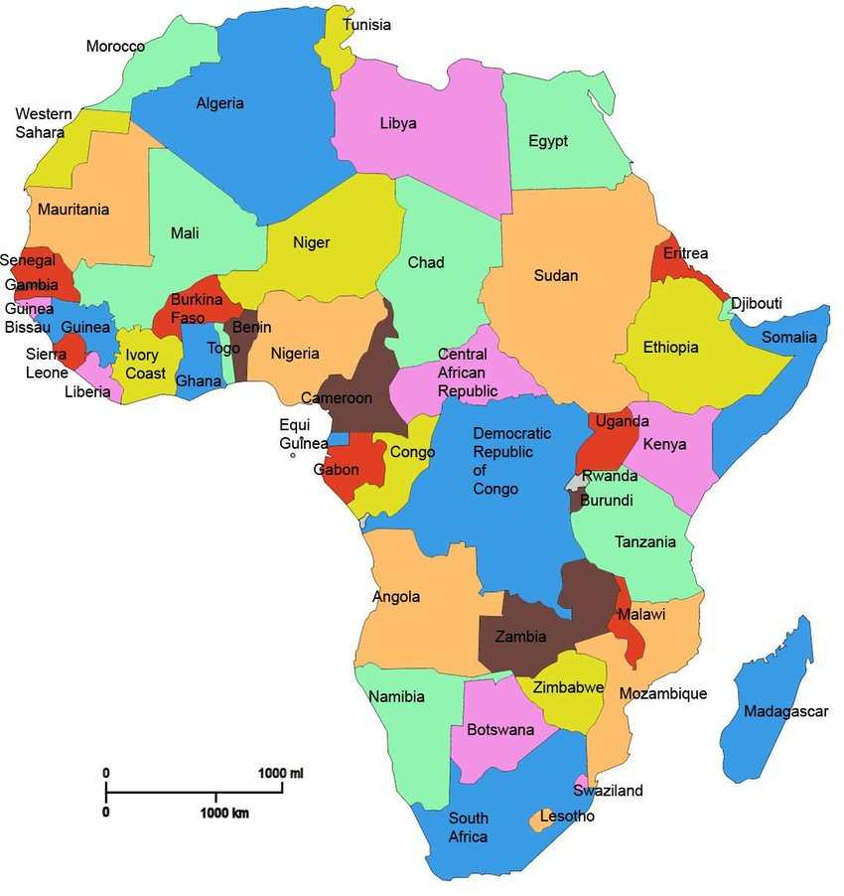
Sierra Leone
MAP OF AFRICA
https://www.researchgate.net/figure/Map-of-Africa-highlighting-countries_fig1_332380173

Slide 3
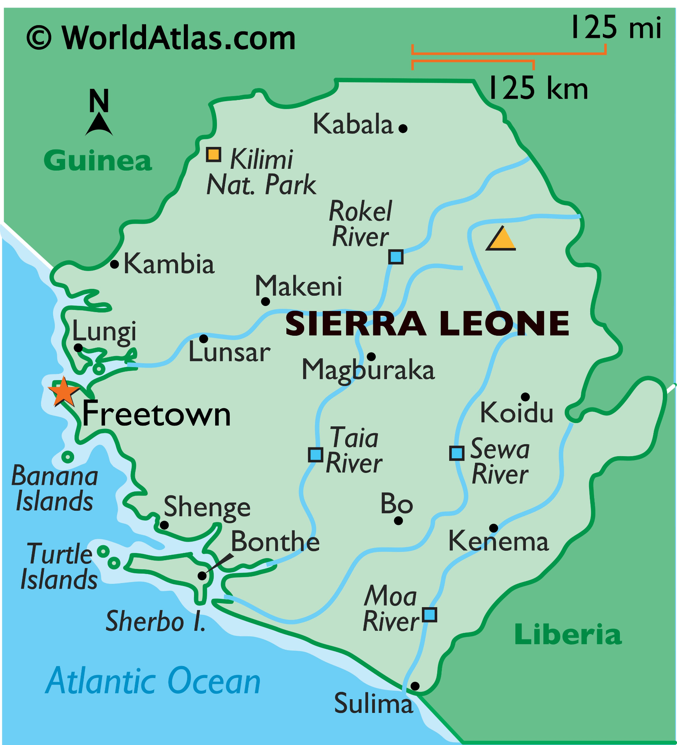
Map of Sierra Leone
https://www.worldatlas.com/maps/sierra-leone

Slide 4
EARLY HISTORY
1462: The recorded history of Sierra Leone begins with the arrival of Portuguese explorers who named the area Serra Lyoa, (Lion Mountains), due to the shape of the mountains.
1600s: The Europeans traded in ivory, timber and slaves. North Americans were also keen on slave trade. Slave trade thrived into the 1800s.
1787: 400 slaves freed from the United States and Britain by British abolitionist groups, settled in the `Province of Freedom’ in Sierra Leone.
1791: The `Province of Freedom’ is renamed `Freetown’ as more freed slaves settle there.

Slide 5
A BRITISH COLONY
1792: Freetown becomes a British Colony.
1808: Sierra Leone becomes a British Crown Colony.

Slide 6
INDEPENDENCE
April 27, 1961: Sir Milton Margai is appointed first Prime Minister when Sierra Leone gains independence from Britain.
1964: Sir Milton Margai dies. Sir Albert Margai, his half-brother, succeeds him as prime minister.

Slide 7
CIVILIAN RULE
May 1967: All People’s Congress wins the elections and Soaka Stevens, ACP leader and mayor of Freetown, becomes the new prime minister. Civilian rule is established.
1968: Siaka Stevens assumes office. His time in office is followed my numerous failed coups, demonstrations and political unrest due to government corruption.

Slide 8
ONE-PARTY STATE UNDER APC
1978: Sierra Leone becomes a one-party state, governed solely by the APC. Other parties are banned.
1985: Major General Joseph Saidu Momoh becomes the next president of Sierra Leone , on Siaka Stevens’ retirement.
March 1991: A group of rebels, The Revolutionary United Front (RUF), rallied together by Liberian leader, Charles Taylor, begin attacking villages in Sierra Leone, on the Liberian border, claiming to be ridding the country of its corrupt APC government.
1995: RUF gains control of many diamond mines, and much of the countryside, and start moving onto Freetown.

Slide 9
CIVIL WAR CONTINUES
1996: Ahmad Kabbah wins the presidential election, as a member of SLPP (Sierra Leone’s Peoples Party).
1997 -2000 : Political unrest continues and civil wars rage across the country. Kabbah’s position is threatened by the RUF’s attempts to take over the country.
May 2000: British troops are deployed to stabilize the situation, resulting in a cease-fire.

Slide 10
STABILITY IS RESTORED
January 2002: President Kabbah declares the civil war officially over and is re-elected for another term.
July 2002: Although Britain withdraws its military support, it continues to train the Sierra Leone army.

Slide 11
CHARLES TAYLOR IS REMANDED
2006: Liberia is granted permission to take Charles Taylor into custody.
April 26, 2012: Charles Taylor is found guilty of abetting horrific war crimes in Sierra Leone.

Slide 12
ADAPTED FROM:
https://www.britannica.com/place/Sierra-Leone
https://en.wikipedia.org/wiki/Sierra_Leone
https://www.sahistory.org.za/place/sierra-leone
https://www.history.com/this-day-in-history/former-liberian-president-charles-taylor-found-guilty-of-war-crimes

