Slide 1
Visual Literacy Images

Slide 2
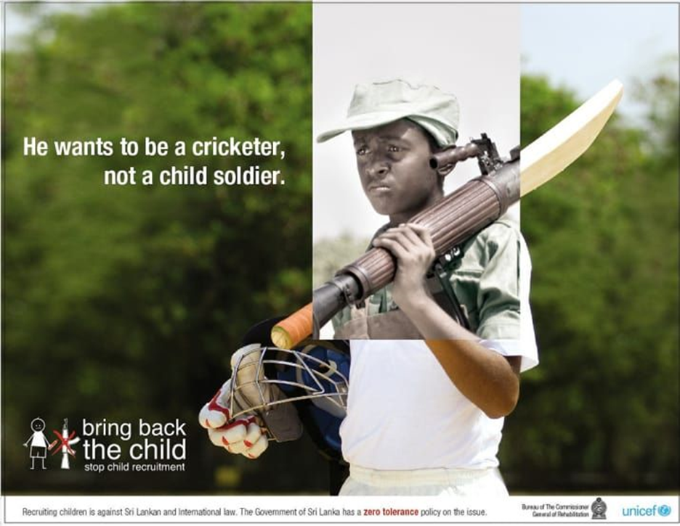

https://www.google.com/search?q=UNICEF+child+soldier+bring+back+the+child&sxsrf

Slide 3

https://www.behance.net/gallery/17334367/Amnesty-International-Stop-Abuse-Now

Slide 4
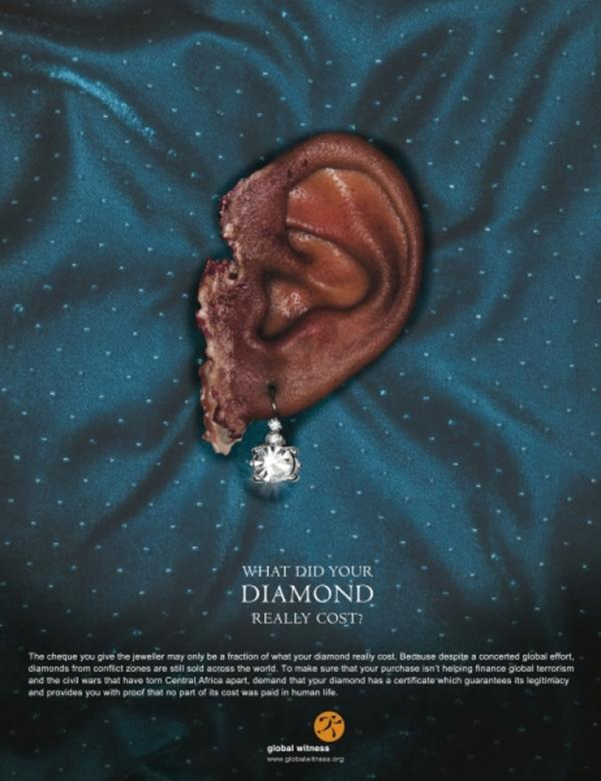
The cheque you give the jeweller may only be a fraction of what your diamond really costs. Because despite a concerted global effort, diamonds from conflict zones are still sold across the world. To make sure that your purchase isn’t helping finance global terrorism and the civil wars that have torn Central Africa apart, demand that your diamond has a certificate which guarantees its legitimacy and provides you with proof that no part of its cost was paid in human life.
https://www.google.com/search?q=conflict+diamonds+ads+what+did+your+diamond+really+cost

