Slide 1
Advertisement
Samples

Slide 2
EXPLORING AIDA

Slide 3
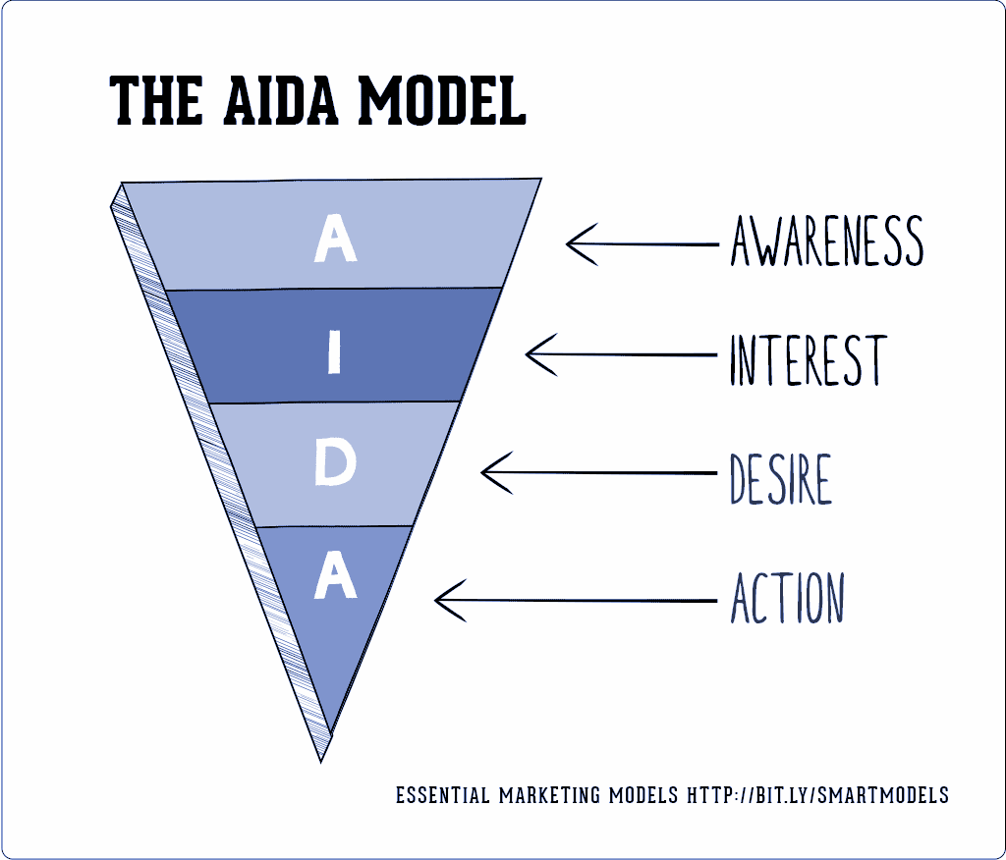
https://imagesapp.goo.gl/MzuvKDKCoUh6D1TRA

Slide 4
Analyse this advertisement using AIDA:
https://images.app.goo.gl/NeBp46wvwEyWa1gP9

Slide 5
Discuss the effectiveness of this advertisement:
https://www.google.com/search?q=best+South+African+a verts&sxsrf

Slide 6
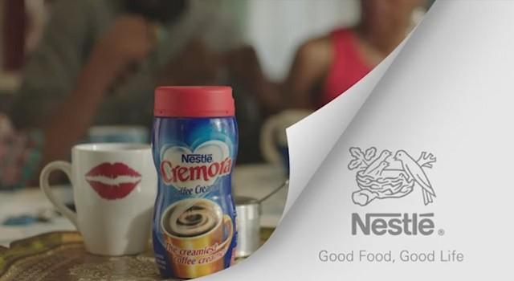
Discuss the effectiveness of the visual and the text:
https://www.google.com/search?q=best+South+African+adverts&sxsrf

