Slide 1
District 6

Slide 2
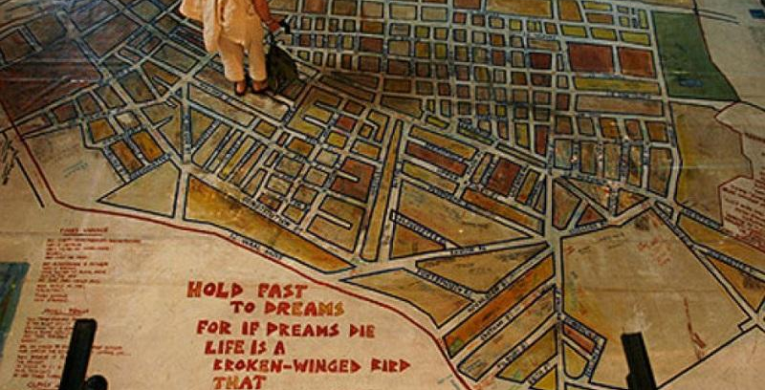
https://www.brandsouthafrica.com/wp-content/uploads/2003/08/district-six-2.jpg

Slide 3
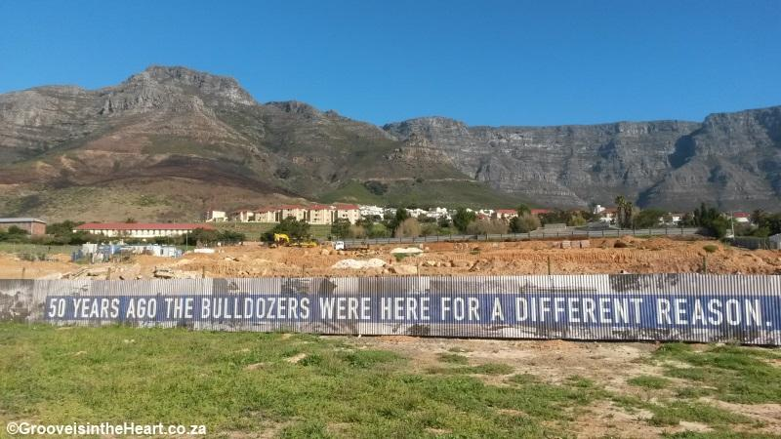
https://www.change.org/p/sa-geographic-place-names-council-reclaim-the-name-district-six/

Slide 4
https://upload.wikimedia.org/wikipedia/commons/1/1d/District-Six-Memory-Plaque.jpg

Slide 5
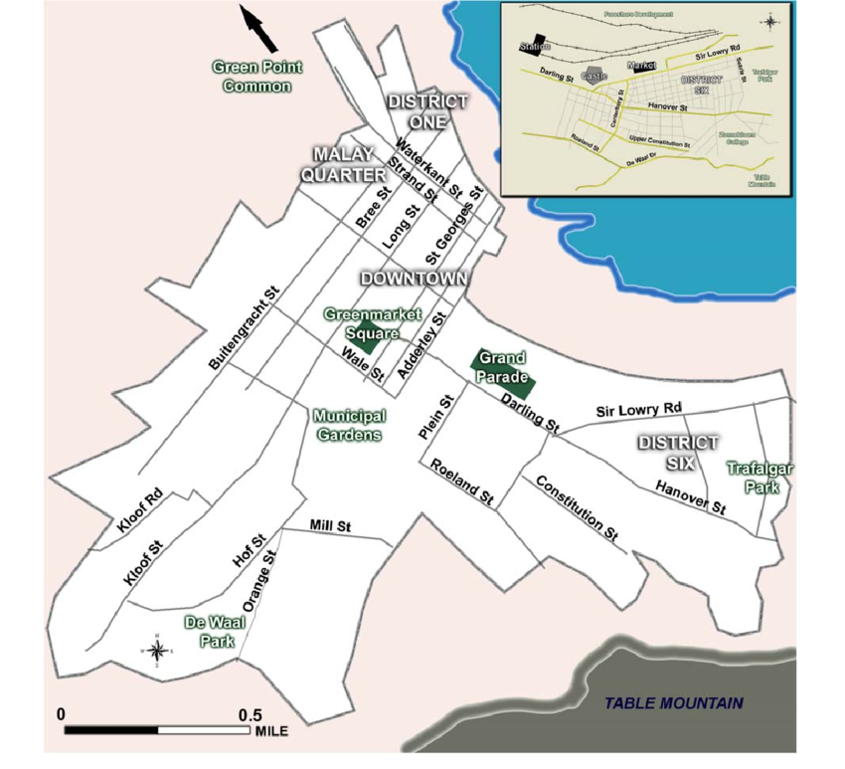
https://www.researchgate.net/figure/Map-of-Cape-Town-and-District-Six-neighborhood-early-twentieth-century-Source-Author_fig1_241732392

Slide 6
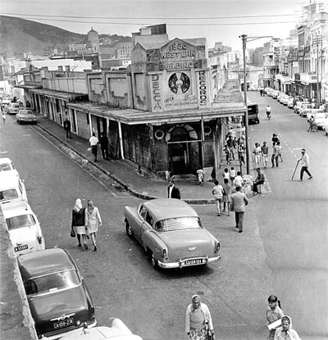
https://www.thesouthafrican.com/lifestyle/remembering-district-six-50-years-later-pictures/

