Slide 1
Buckingham Palace
England

Slide 2
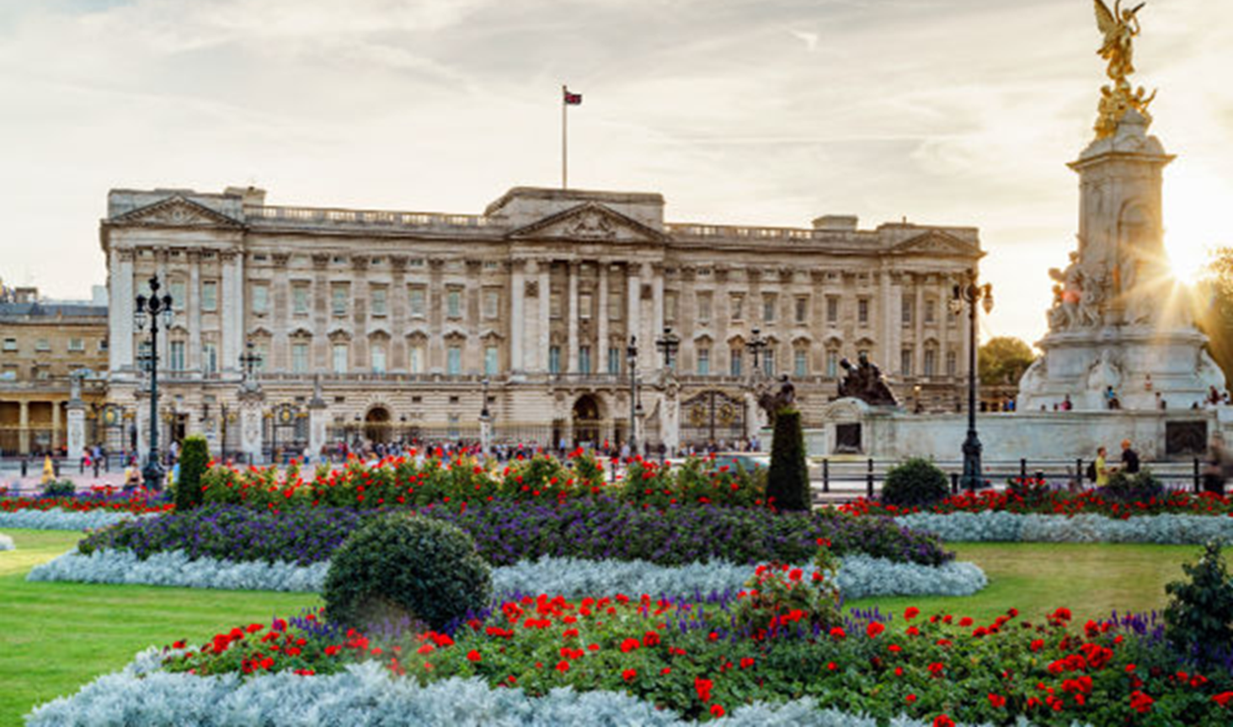
https://www.visitlondon.com/things-to-do/sightseeing/london-attraction/buckingham-palace-top-10

Slide 3
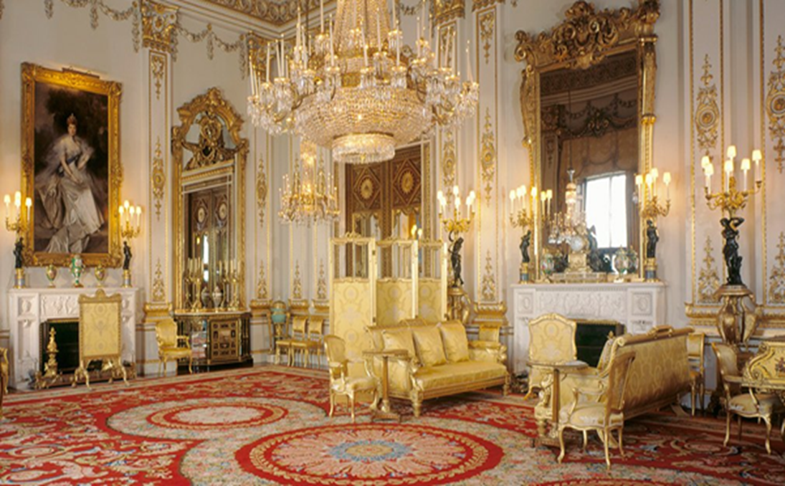
https://www.rct.uk/visit/the-state-rooms-buckingham-palace/highlights-of-buckingham-palace#/

Slide 4
Windsor Castle
England

Slide 5
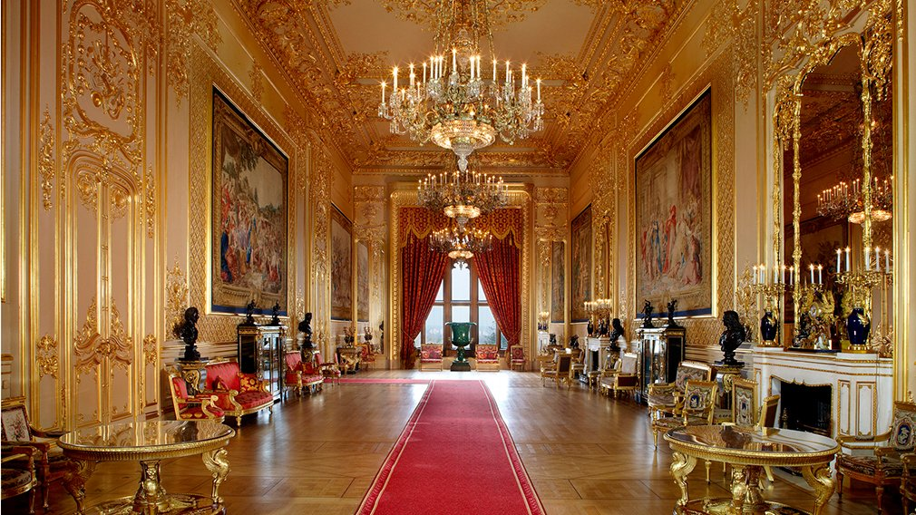
https://www.rct.uk/visit/windsor-castle/highlights-of-windsor-castle#/

Slide 6
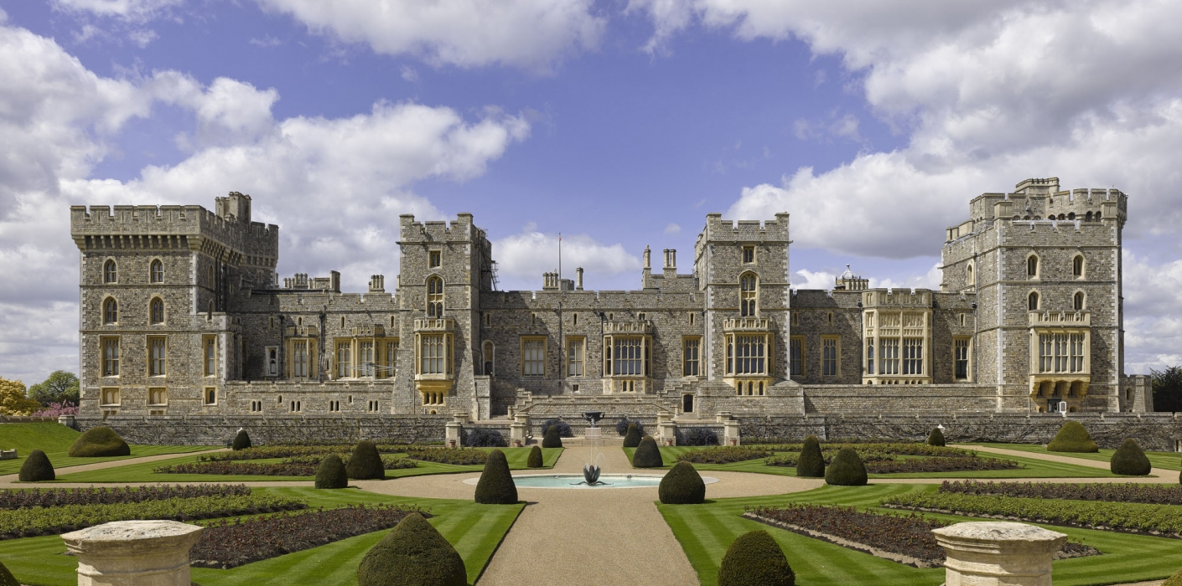
https://images.app.goo.gl/uouVeYRbysk7H9EC8

Slide 7
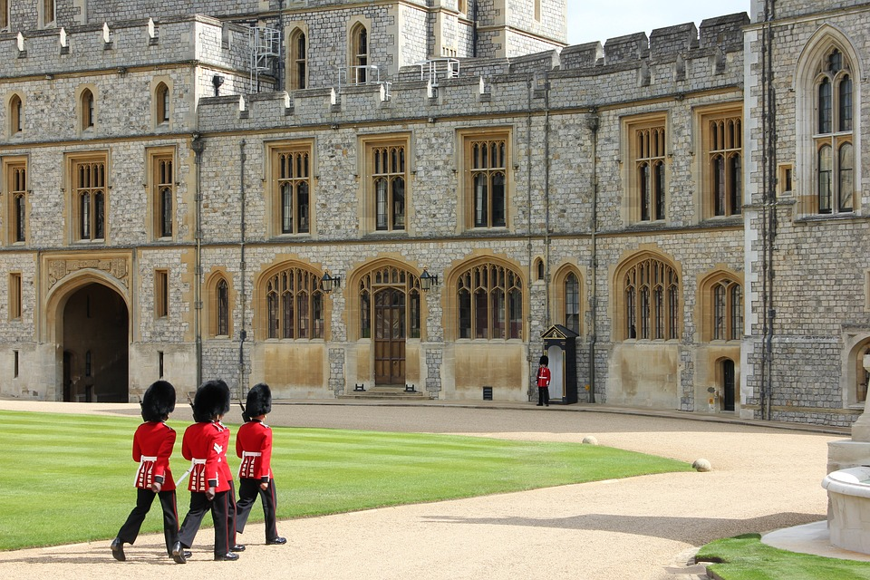
https://pixabay.com/photos/windsor-castle-windsor-royal-guard-4223726/

