Slide 1
Kalk Bay

Slide 2
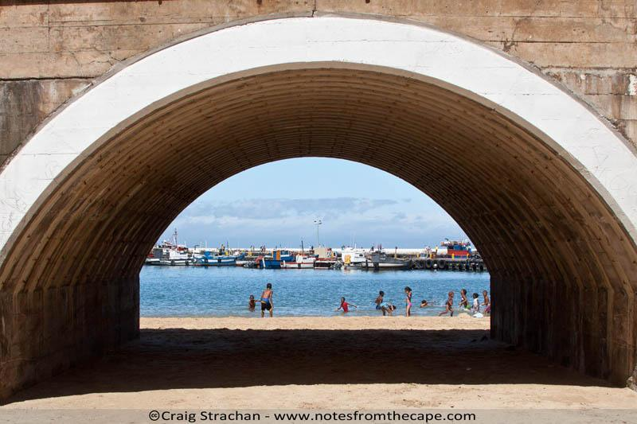
https://www.notesfromthecape.com/

Slide 3
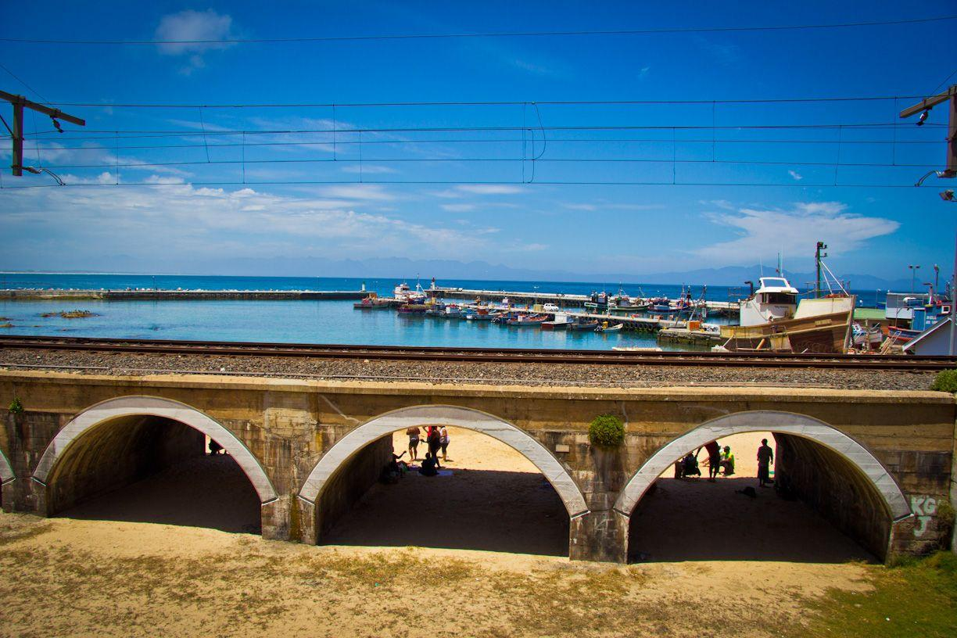
https://www.google.com/search?q=pictures+of+kalk+bay++and+bridge+cape+town+and+the+&tbm

Slide 4
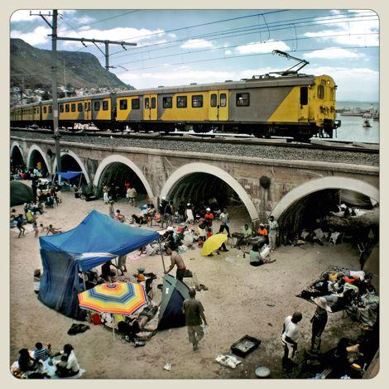
https://www.google.com/search?q=pictures+of+kalk+bay++and+bridge+cape+town+and+the+&tbm

Slide 5
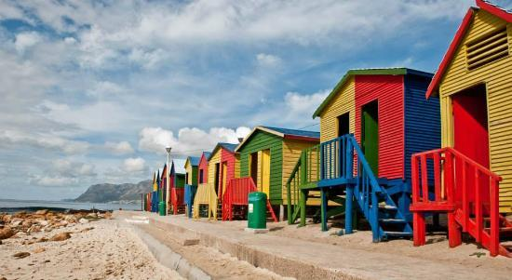
ttps://www.google.com/search?q=kalk+bay+cape+town&sxsrf

