Slide 1
Poetry Analysis Guidelines

Slide 2

STEP 1: WHAT DOES THE LEARNER BRING TO THE LESSON?
1. Educator reads the poem to the learners.
2. Learners to read the poem to themselves.
3. Learners to comment on anything they find interesting or inspiring.
4. There are no wrong answers if they can be justified.
5. They may ask a question or express their disbelief at something.

Slide 3
STEP 2: WHAT IS THE CONTEXT?
1. UNDERSTAND THE:
1.1 historical/political/social context.
1.2 the period in which the poet lived.
1.3 the period the poet is writing about.
1.4 the poet’s views and beliefs.
2. WHAT IS THE STORY BEING TOLD IN THE POEM?

Slide 4
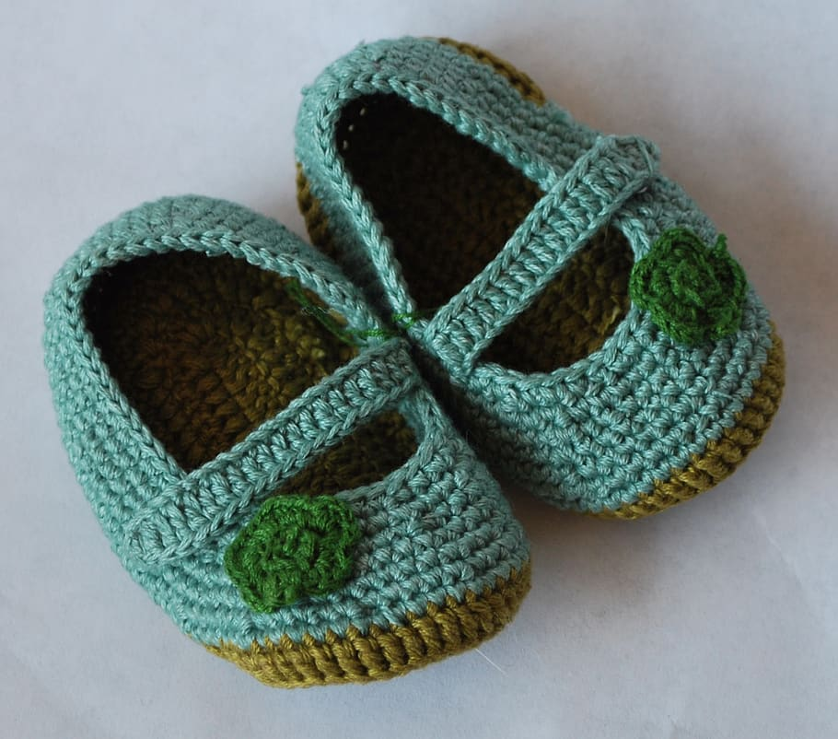
STEP 3: ASPECTS OF A STORY
For sale: Baby’s shoes. Never worn.
by Ernest Hemingway
What is the story behind the advert?
What emotions of the characters are explored in the story?
Intrigue
Mystery
Hope
Dreams
Hope
Dreams
Intrigue, Mystery
Hope, Dreams
Despair, Desolation
What is the writer’s: intention, main idea,
theme?
How do you feel after reading it? MOOD

Slide 5
STEP 4: TECHNIQUES USED
The Importance of the Spaces Between …
iwenttothegardenofloveandsawwhatIneverhadseenachapelwasbuiltinthemidstwhereiusedtoplayonthegreen
Words Give Meaning.
Diction
Figures of Speech
Word Order
Parts of Speech
STYLE/FORMAT of the POEM
Shape of the poem.
Enjambment.
Syllables per line.
Caesura
Rhyming Couplets
The Importance of Punctuation.
That that is is that that is not is not that that is not is not that that is.

Slide 6
SUMMARY
1. WHAT DOES THE LEARNER BRING TO THE LESSON?
Learners to comment on anything they find interesting or inspiring.
They may ask a question or express disbelief.
the period in which the poet lived.
2. WHAT IS THE CONTEXT?
the historical/ political/ social context.
Consider
the period the poet is writing about.
the poet’s values and beliefs.
3. ASPECTS OF THE STORY
What is the story in the poem?
What is the poet’s intention? THEME
What emotions are explored?
What is the tone and mood?
4. WHAT TECHNIQUES ARE USED?
Diction
Imagery
Style/Format
Punctuation
Spacing

Slide 7
SOME TONE WORDS
POSITIVE
NEGATIVE
HUMOUR, IRONY, SARCASM
SORROW, FEAR, WORRY
ROMANTIC
ENTHUSIATIC
JUBILANT
PROUD
OPTIMISTIC
ELEVATED
AMUSED
BITTER
AGITATED
CRITICAL
DESPERATE
HATEFUL
INSULTING
THREATENING
CONDESCENDING
FLIPPANT
PATRONISING
AMUSED
SARCASTIC
TAUNTING
MALICIOUS
APPREHENSIVE
PARANOID
PESSIMISTIC
MELANCHOLY
FOREBODING
EMBARRASSED
APOLOGETIC
NEUTRAL
DRAMATIC PRETENTIOUS CONTEMPLATIVE NOSTALGIC BAFFLED INTIMATE INQUISITIVE
INFORMATIVE JUDGEMENTAL OBSEQUIOUS HUMBLE INCREDULOUS MEDITATIVE ZEALOUS

