Slide 1
Structure of the Plot

Slide 2



THE PLOT
This is the sequencing of events to create a story. There are 5 essential parts of the plot:

Slide 3
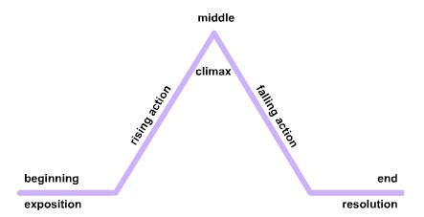
http://ontrack-media.net/english_gateway/E6/g_E6RdM2L3/g_E6RdM2L3s2a.html

Slide 4
EXPOSITION
This is the beginning of the story. It introduces:
Characters
Setting
Some aspects of the story
Some aspects of the conflict

Slide 5
EXPOSITION IN TSOTSI
Tsotsi and his gang (Boston, Butcher and Die Aap)
are in a township waiting for darkness.
It is Friday night and pay day for workers.
They choose Gumboot Dhlamini as their victim.
His murder leaves Boston sick, and Boston
questions their `decency’.

Slide 6
RISING ACTION
This relates to events that are unresolved and that lead to the climax.
These events, by revealing character flaws and background circumstances, create suspense and tension.

Slide 7
RISING ACTION IN TSOTSI
Boston questions and taunts Tsotsi.
Tsotsi assaults Boston and runs away from Boston.
It is in this time that he takes responsibility for the baby.
He stalks Morris.

Slide 8
THE CLIMAX
This is the turning point of the story.
It is the highest level of suspense or action.

Slide 9
CLIMAX IN TSOTSI
Through his interaction with Morris, Tsotsi:
understands that he can make choices.
understands that mothers love their children.
remembers his past.
names the baby David.

Slide 10
FALLING ACTION
These are events that occur after the climax.
These events lead to the resolution.

Slide 11
FALLING ACTION IN TSOTSI
Tsotsi breaks all ties with the gang.
He finds Boston and takes care of him.
He has a conversation with Isaiah about God.
He decides to go to church.

Slide 12
RESOLUTION
This is the end of the story where the conflicts and problems are resolved.

Slide 13
RESOLUTION IN TSOTSI
Tsotsi has regained his identity.
He dies trying to save the baby.
His smile suggests his redemption.

